Slide 1
Enum Types

Slide 2
Enum
An enum type is a special data type that enables a variable to be a set of predefined constants. The variable must be equal to one of the values that have been predefined for it. Common examples include compass directions (values of NORTH, SOUTH, EAST, and WEST) and the days of the week.
Because they are constants, the values of an enum’s fields are in uppercase letters.

Slide 3
Enum
In the Java programming language, you define an enum type by using the enum keyword. For example, you would specify a days-of-the-week enum type as:
public enum Day {
SUNDAY, MONDAY, TUESDAY, WEDNESDAY,
THURSDAY, FRIDAY, SATURDAY
}
Create this by File|New|Enum

Slide 4
When to use
You should use enum types any time you need to represent a fixed set of constants. That includes natural enum types such as the planets in our solar system and data sets where you know all possible values at compile time—for example, the choices on a menu, command line flags, and so on.

Slide 5
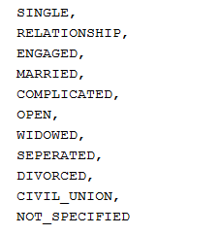
Relationship (write in alphabetical order)

Slide 6

Gender (write in alphabetical order)
NON_BINARY

Slide 7
Checking an Enum
If (this.gender==Gender.MALE)
Making a friend using enum fields
Friend sharmi = new Friend("Sharmila", "Savarimuthu", 1983, 12, 18, Gender.FEMALE, "Christchurch", "amala@yahoo.com", Relationship.MARRIED);

